Slide 1
CA II – November 15 Assignment
Week 11 Vocabulary
Be MAD EXCITED! WOOT! WOOT!

Slide 2
Directions
Open the Week 11 Vocabulary from the website
Each slide needs to include the following
The root word(s)
The meaning of the root word(s)
A complete sentence using one of the examples for that root word
A picture (and source! Include the url!) that represents the root word(s)
3. Choose two root words from Week 10 and two root words from Week 9 (both lists are on the website) and complete the above steps for those root words

Slide 3
Directions Continued
4. Save your assignment as yournamevocabpp
5. Email your assignment to Mrs. Engelage & Mrs. Hallmark
ahallmark@joplin.k12.mo.us
aengelage@joplin.k12.mo.us

Slide 4
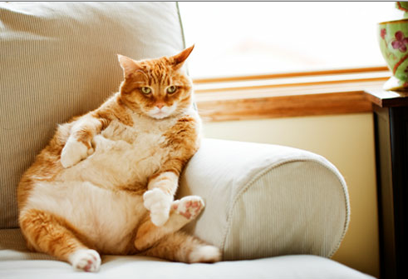
Example
sed, sess
Meaning: sit
Example sentence: My cat, Simon, prefers a sedentary lifestyle.
http://img.webmd.com/dtmcms/live/webmd/consumer_assets/site_images/articles/health_tools/pet_treats_slideshow/getty_rm_photo_of_extremely_fat_cat_on_sofa.jpg

Slide 5
And, finally…
…be good.
…stay on-task.
…get this assignment finished!

